Slide 1

ESEM and OpenMBEE supporting the SE Lifecycle Change Process – TMT Case Study
An Executable MBSE Method (ESEM) to
Support Requirements Analysis and Verification
March 31, 2017
Robert Karbanª, Sebastian Herzigª,
Amanda Crawford^{a,}Jamie Nakawatase^{b} ^{b}Thirty Meter Telescope International Observatory
ªJet Propulsion Laboratory, California Institute of Technology
Notes:
25+5 minutes presentation
An Executable MBSE Method (ESEM) to Support Requirements Analysis and Verification

Slide 2
Outline
Current State of Practice and Need for MBSE
System Development Process
Introduction to Thirty-Meter Telescope (TMT)
Model Walkthrough
ESEM Process Overview
ESEM as Implemented in TMT model

Slide 3
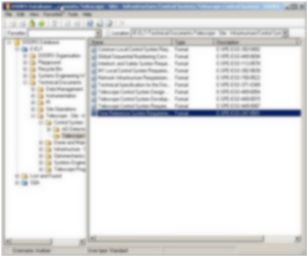
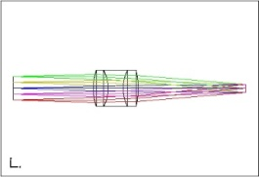
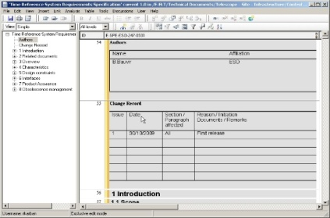
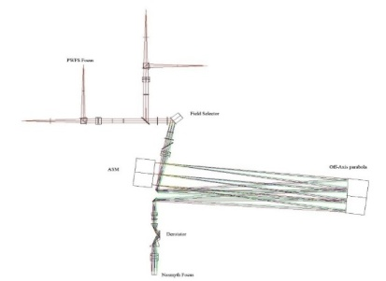
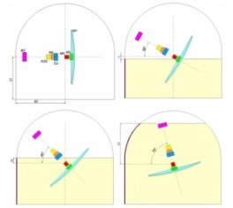
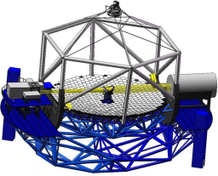
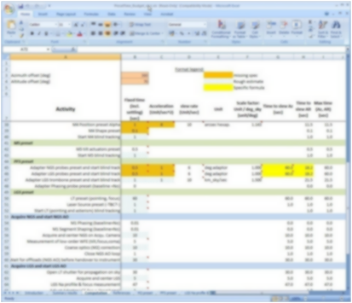
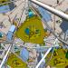
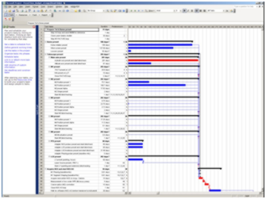
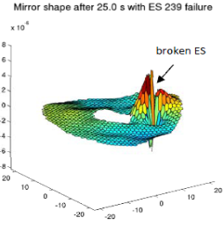
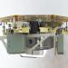
Current State of Practice and Need for MBSE
Current State or Practice
Modeling is ubiquitous in domain specific engineering (CAD, FEA, MATLAB)
Many other document based artifacts
The Need for MBSE
Tie in system level models into existing modeling
Provide method and tooling environment to do it

Slide 4






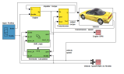
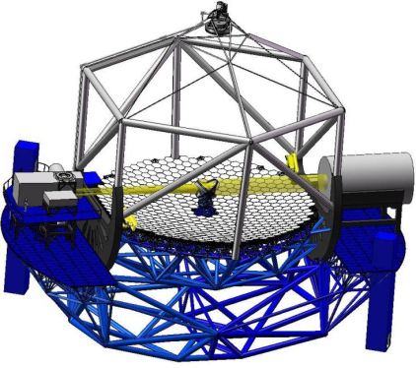
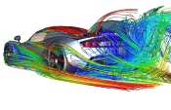





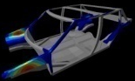
Systems Engineering Inadequacies of A Traditional Document-Based Approach
Finance
Software
Analysis
Implicit Dependencies between Documents
Project Management
Power plant
Structure
Control
Mirrors
…
Manufacturing
CAD
Notes:
Many stakeholder, all with their own view of the vehicle / Enterprise
But they are all views of the SAME system → the views depend on each other
Currently, dependencies are often implicitly represented, hidden in documents
Emphasize RISK!!! And consistency…
(S)Es are busy to find out what other SEs or Engineers do...
Many people still think they are able to keep all under control using documents and their brain ☺

Slide 5
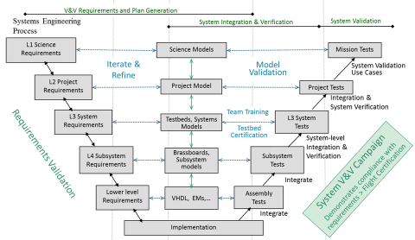
Model-based V-Process at JPL

Slide 6
Proposed Approach
Next phase of system modeling emphasizes executable models to enhance understanding , precision, and verification of requirements
Executable Systems Engineering Method (ESEM) augments the OOSEM activities by enabling executable models
ESEM produces executable SysML models that verify requirements
Includes a set of analysis patterns that are specified with various SysML structural, behavioral and parametric diagrams
Also enables integration of supplier/customer models

Slide 7
Executable Models
Most SysML models today are created for documentation purposes
The focus is on syntax and notation
Some SysML models are created to gain system understanding, explore and validate desirable or undesirable behaviors of a system
The focus is on semantics

Slide 8
Object Oriented System Engineering Method
Defines the architecture in terms of:
Domain: the context of the solution
Enterprise: the ecosystem of the solution
System of Interest: the solution being specified
Black Box: externally visible specification
Conceptual: white box functional specification
Physical: white box realization specification

Slide 9
Model Execution
Executable SysML models are defined with a subset of the language with well defined execution semantics
The subset is called Foundational UML (fUML)
SysML inherits the fUML subset from UML
SysML models are executed with the help of an execution, or simulation engine
Ex.: NoMagic’s Cameo Simulation Toolkit (CST)

Slide 10
Cameo Simulation Toolkit (CST)
A plugin to MagicDraw SysML modeling tool
A simulation platform based on fUML and plugs in additional execution engines
State Chart XML (SCXML)
Scripting for the Java Platform (JSR 223)
Precise Semantics of Composite Structures (PSCS)
Precise Semantics for State Machines (PSSM)

Slide 11
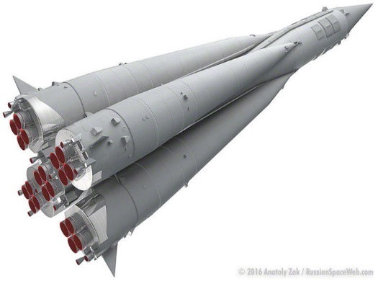
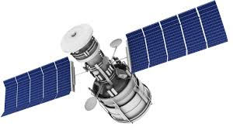
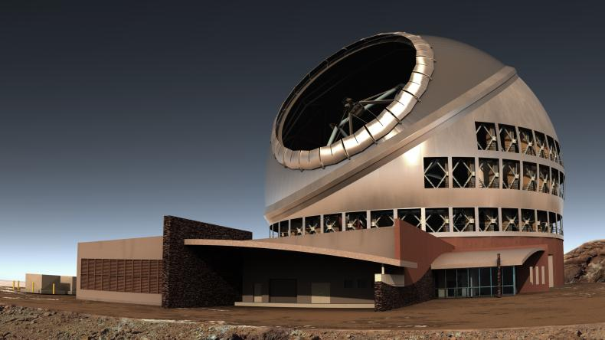
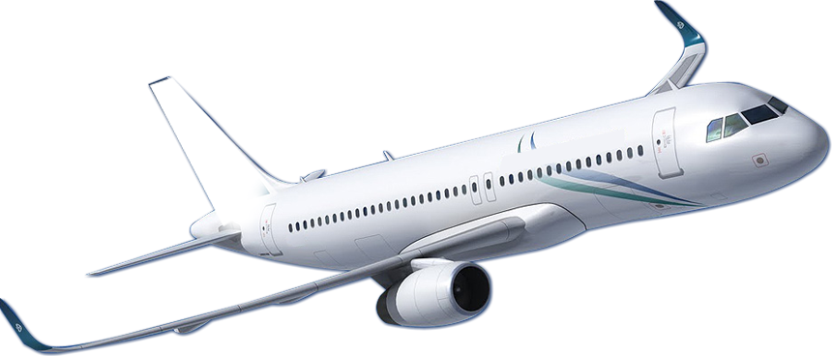


Complexity of TMT
The Thirty Meter Telescope (TMT) is no different than other complex systems of systems
We still need to apply core SE processes
Difference: telescope community is historically unfamiliar with formal Systems Engineering

Slide 12
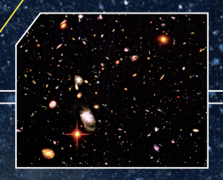
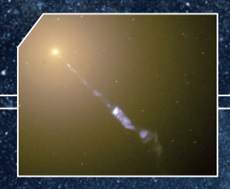
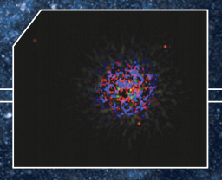
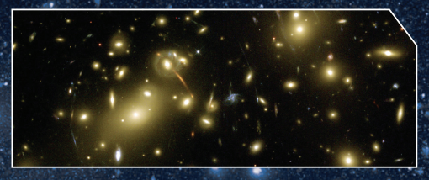


TMT Key Science
Nature and composition of the Universe
Formation of the first stars and galaxies
Evolution of galaxies
Relationship between black holes and their galaxies
Formation of stars and planets
Nature of extra-solar planets
Potential of life elsewhere in the Universe
Unforeseen discoveries…

Slide 13
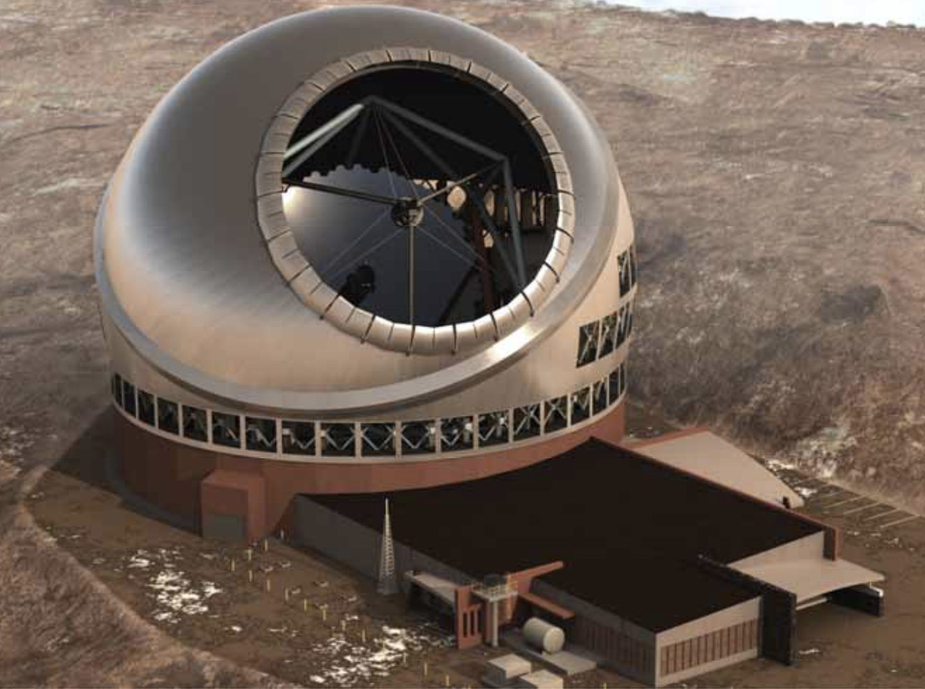
TMT Project
TMT Project formed in 2004
TMT international partnership grew
US (Caltech & UC), Canada, China, India, Japan
2004 – 2008 site studies
Chile, Mexico, Hawaii
Mauna Kea, Hawaii selected in 2009
2014 start of TMT Construction Phase
Notes:
Formation: Association of Canadian Universities for Research in Astronomy (ACURA), Caltech, UC, AURA (associate)

Slide 14
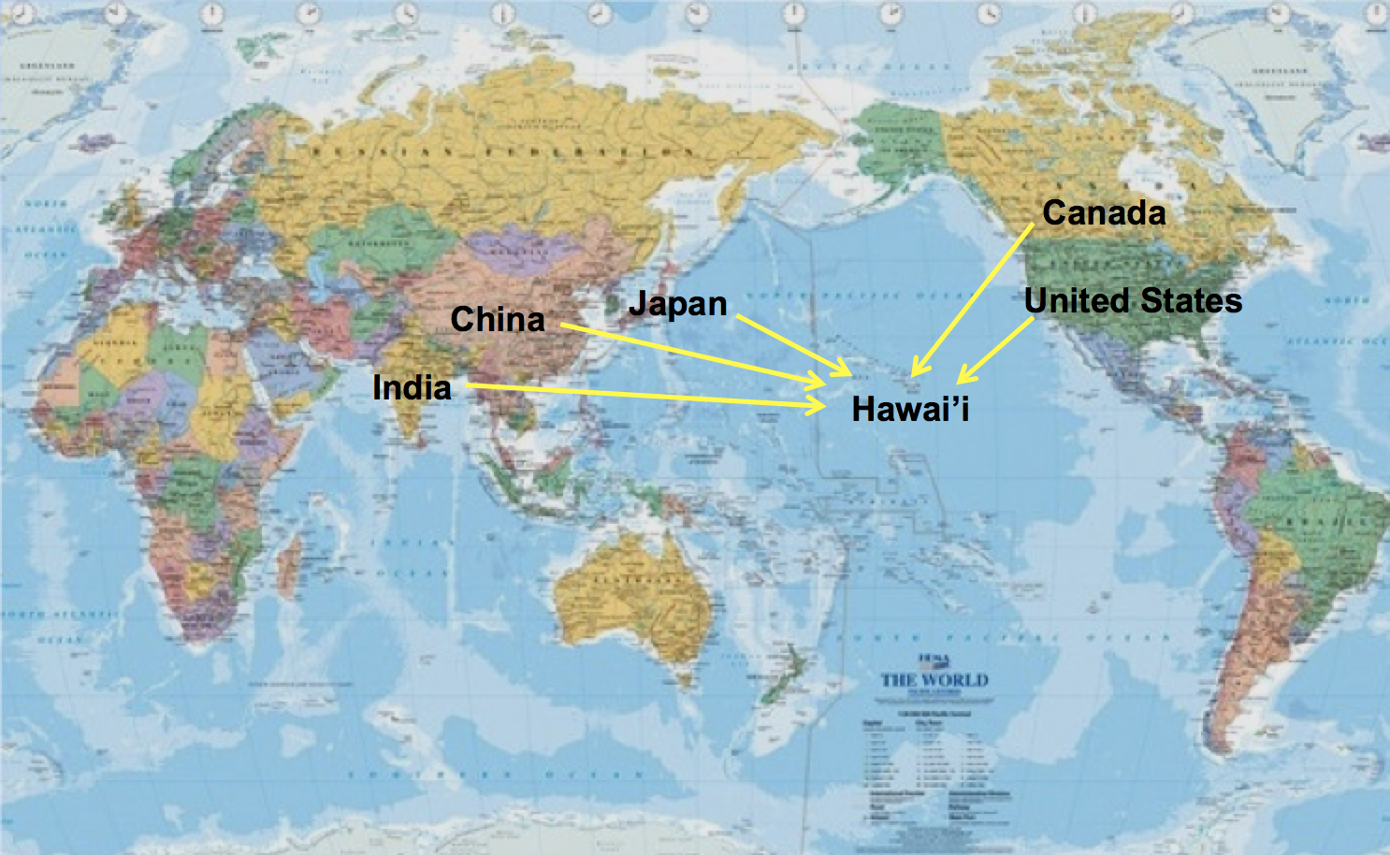
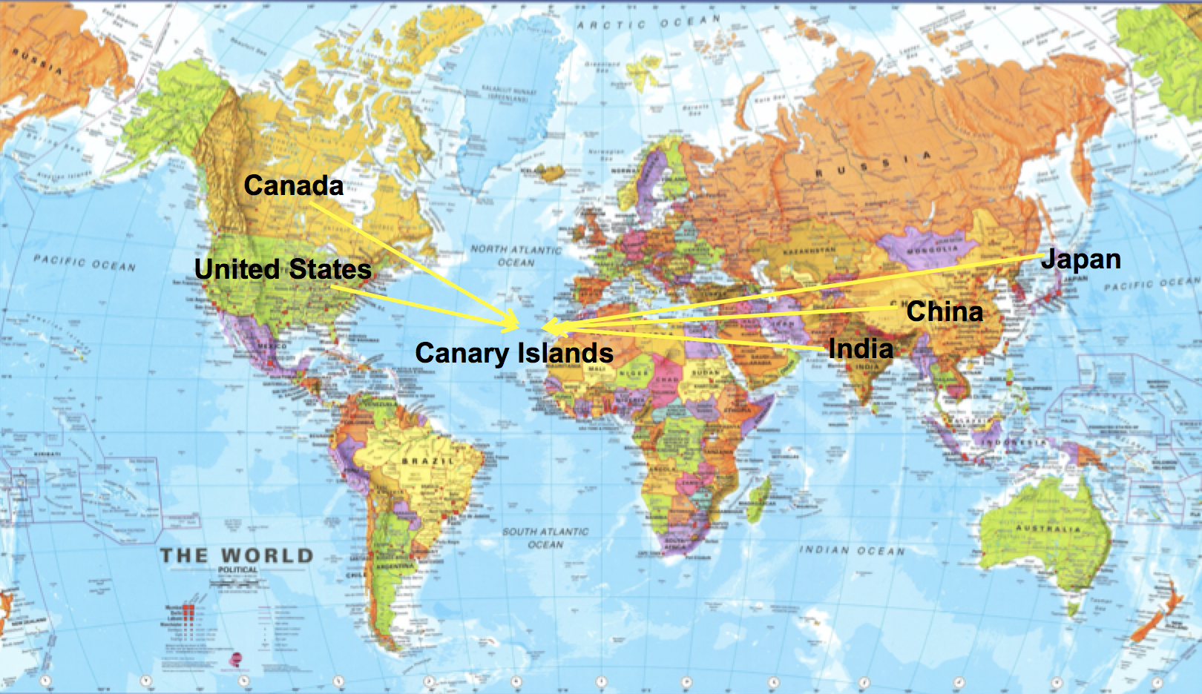
TMT Site
Preferred site:
Mauna Kea on the Big Island of Hawaii, United States
Alternate site:
Observatorio del Roque de los Muchachos (ORM) on La Palma in the Canary Islands, Spain
Notes:
Oct 2014: Groundbreaking ceremony, interrupted by protests
Dec 2015: HI Supreme Court revoked state Conservation District Use Permit
Jun 2016: Contested case hearings began (Oct 2016 in Hilo)
Mar 2017: Evidentiary Hearings of CDUP Contested Case came to a close. Parties have until mid-May to submit proposed findings of fact. Judge Amano will then make her decision.

Slide 15

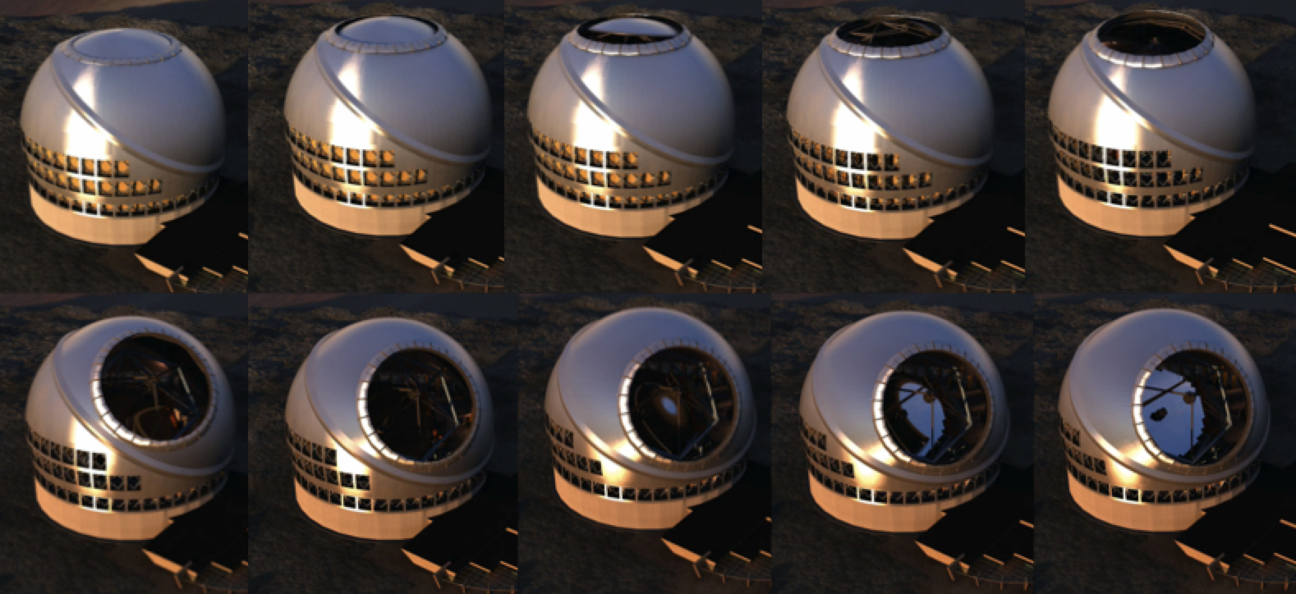
TMT Enclosure
Calotte design
Azimuth rotation on fixed base ring
Rotation of cap structure on tilted bearing ring
Aerodynamic design minimizes degradation image quality due to air turbulence and thermal influences
Smooth exterior
Minimal size aperture
Aperture flaps
Ventilation doors
Notes:
Dynamic Structures Ltd.
Vents (4m x 5m)

Slide 16

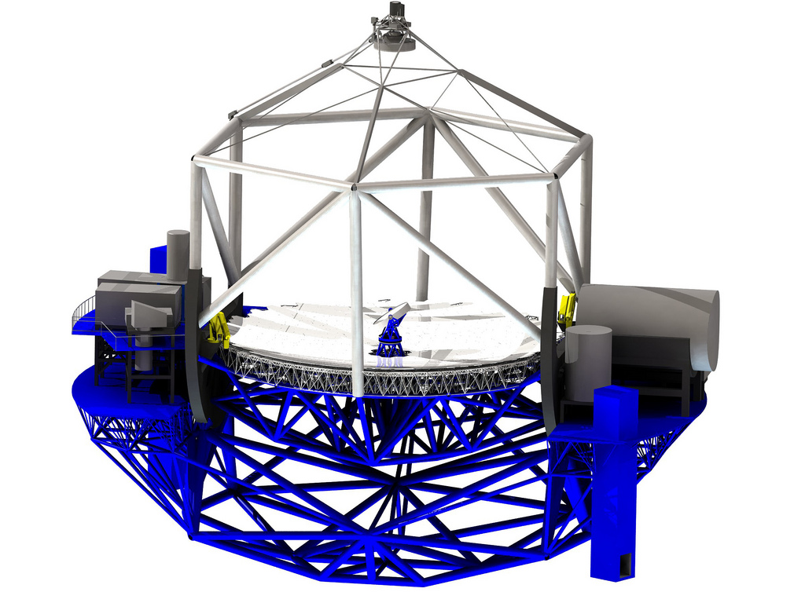
TMT Structure
Elevation structure
Mounting support for optics and laser guide star facility
Azimuth structure
Supports elevation structure and 2 large Nasmyth platforms for instruments and AO systems
Elevators, stairs, walkways, and all utility lines
Notes:
Mitsubishi Electric Co. (MELCO)

Slide 17



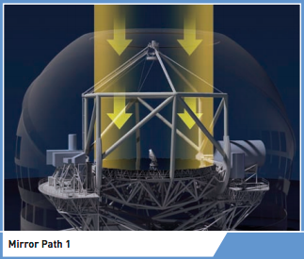
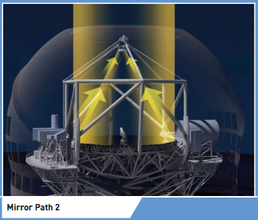
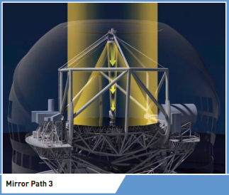
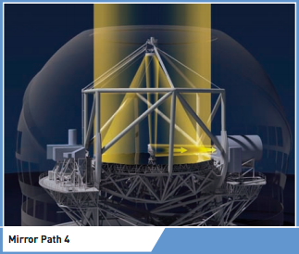
TMT Optics
3x larger, 9x more powerful than today’s best telescopes
Ritchey-Chrétien design
Segmented primary mirror (M1)
492 segments, < 2 m across
Collects/concentrates light
Secondary mirror (M2)
Works with M1 to form well-corrected focus
Tertiary mirror (M3)
Steers light to adaptive optics system and science instruments on Nasmyth platforms
Notes:
Why 30 meters?
Observations limited by atmospheric turbulence improve in sensitivity as diameter squared (D2)
AO systems allow us to remove turbulence effects and achieve diffraction-limited imaging
Segmented mirror techniques pioneered by Keck Observatory
Limited by cost and technology

Slide 18
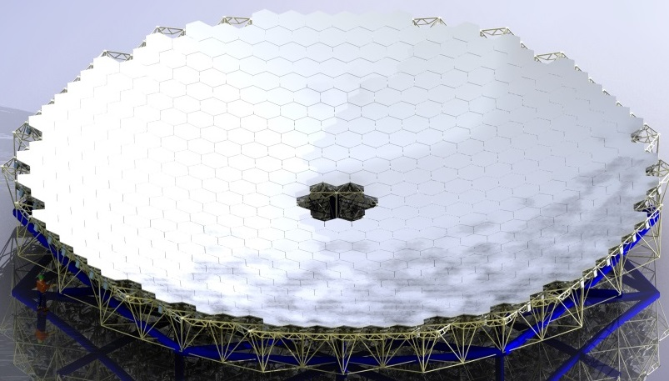
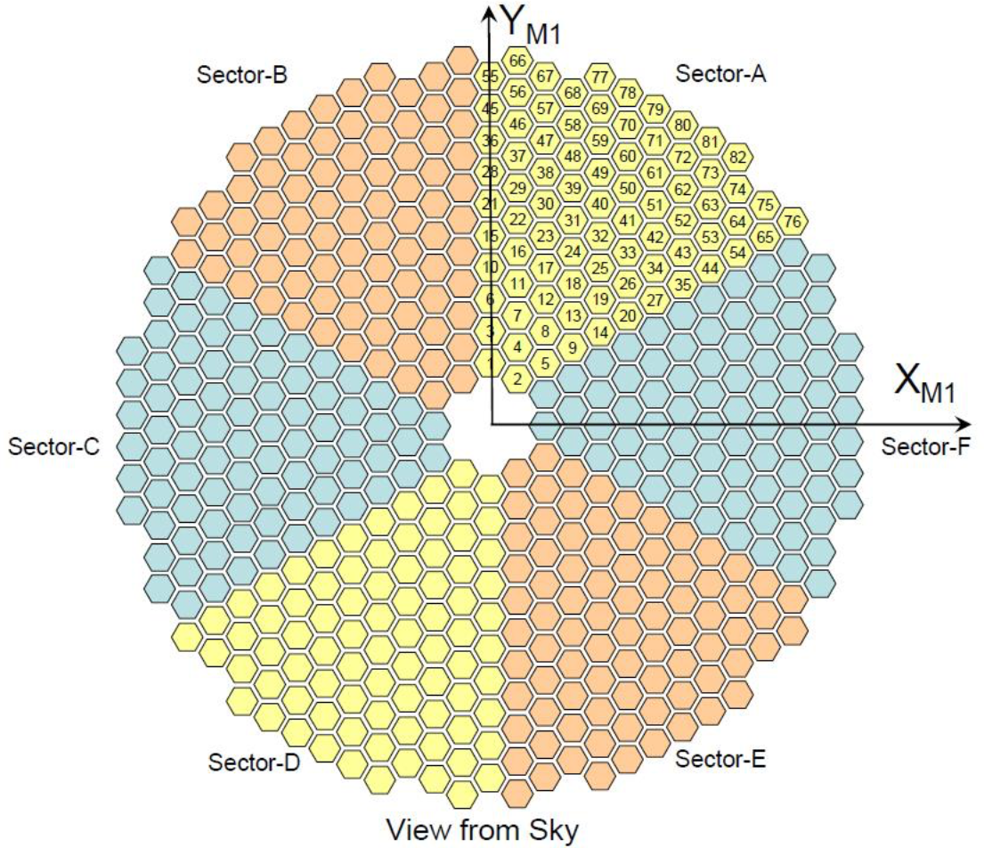
Primary Mirror (M1)
Segmented primary mirror
492 hexagonal segments
1.44 m across corners
2.5 mm gaps (0.1 in, 0.6% lost area)
Thin glass (~2 in) reduces mass and thermal inertia
Reduces difficulties:
Fabrication
Testing
Transportation
Reduces risks:
Breakage of single segment is less catastrophic
Moderate cost and complexity
Notes:
Glass temperature can follow changing ambient temp to minimize mirror seeing effects
Segment blanks: Japan (Ohara)

Slide 19
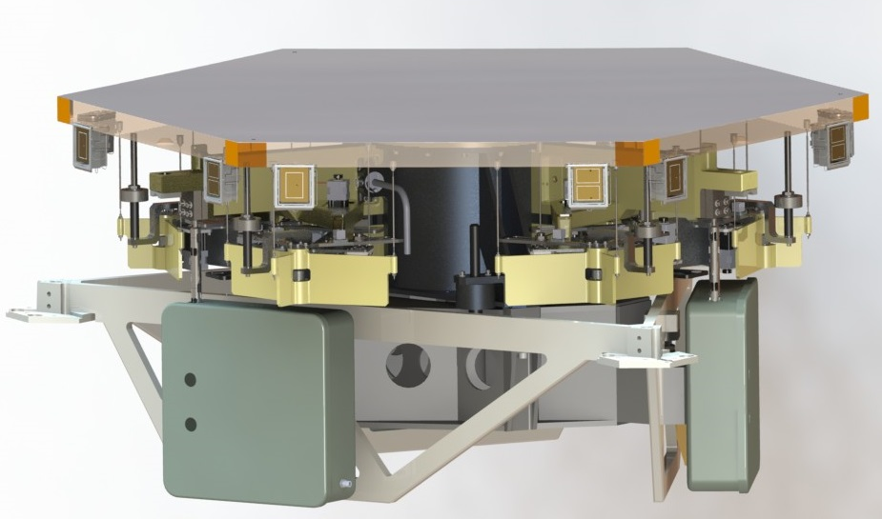
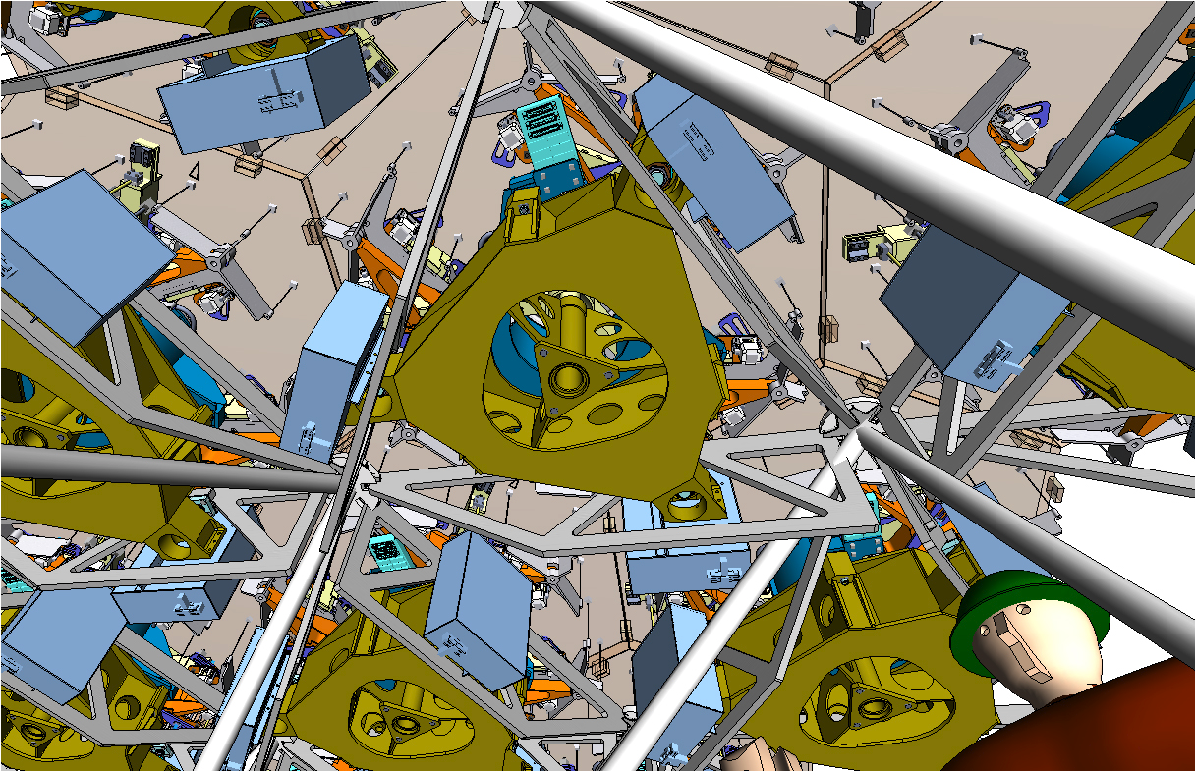
M1 Segments
Segment blanks (round, 1.52m) manufactured in Japan (Ohara)
Segment polishing in the US (Coherent), Japan (Canon), China (NIAOT), and India (IIA)
Segment support system holds each segment in place without distortion from gravity (manufactured in US)
Notes:
NIAOT: National Institute of Astronomical Optics and Technology
IIA: Indian Institute of Astrophysics

Slide 20
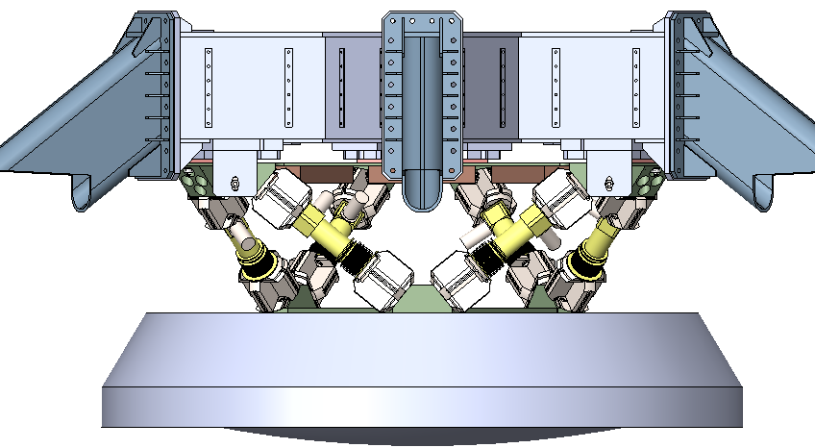
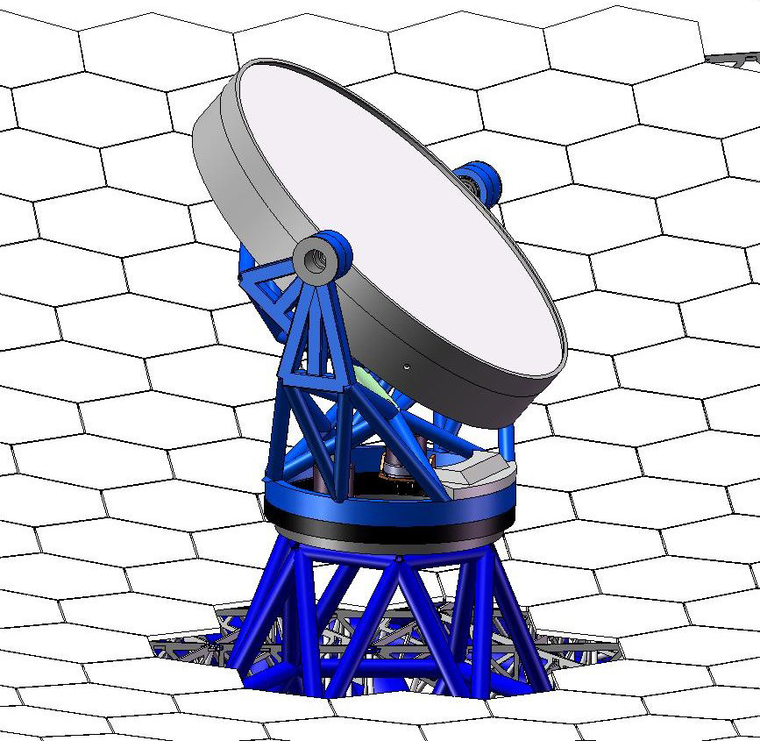
Secondary and Tertiary Mirrors (M2 and M3)
Secondary Mirror (M2)
3.1 m convex hyperboloid mirror
Mounted to telescope top end
Tertiary Mirror (M3)
2.5 m x 3.5 m flat steerable mirror
Rotates and tilts to deliver image to instruments on Nasmyth platforms
China (CIOMP) is responsible for design and fabrication
Notes:
CIOMP = Changchun Institute of Optics, Fine Mechanics and Physics

Slide 21
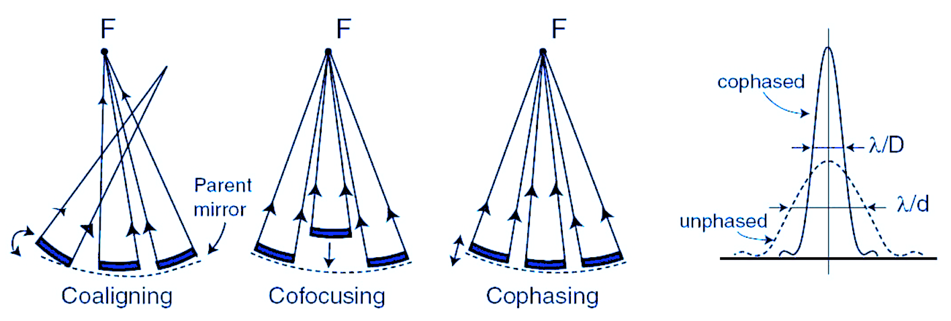
Segmented Mirror Control
Segmented M1 must perform like a single, smooth mirror to provide optimal image quality
Coaligning: stacking images produced by each segment to form single image
Cofocusing: focal lengths of individual segments are equal
Cophasing: no discontinuities between edges of neighboring segments
If not phased, image quality = that of individual segment
PSF

Slide 22
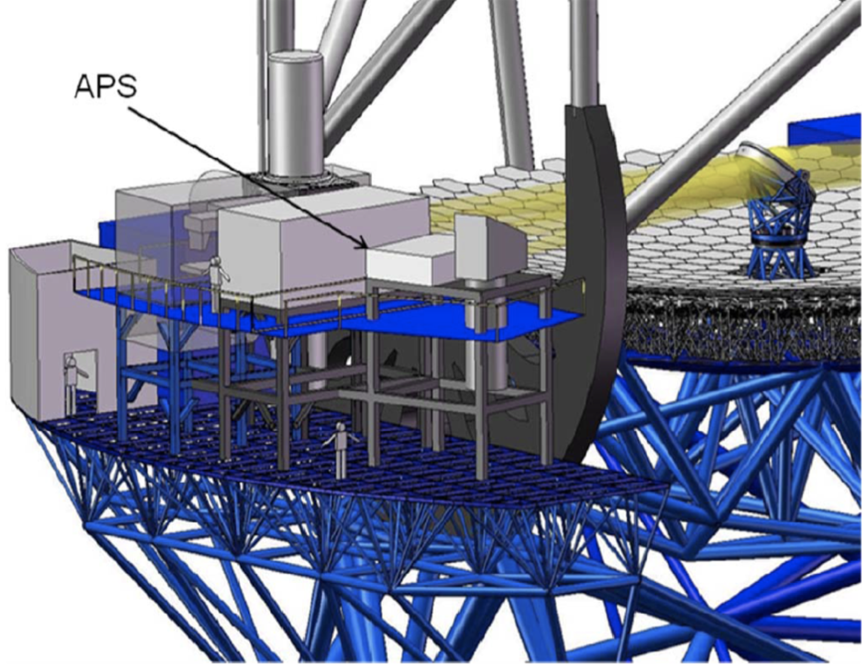
Alignment and Phasing System (APS)
Alignment and diagnostic instrument located on a Nasmyth platform
Modified Shack-Hartmann wavefront sensor
Responsible for pre-adaptive optics wavefront quality
Uses starlight to measure wavefront errors and determine commands to send for aligning optics

Slide 23
Typical Analysis Activities Using ESEM
Capture operational use cases with estimated durations of actions, e.g.
Post segment-exchange alignment: requirement: 2h; CBE 1h19m
Capture power and mass characteristics of components
Identify involved subsystems, e.g. Telescope Control System (TCS), M1 Control System (M1CS)
Identify interfaces and interactions among subsystems
Analyze associated scenarios
Automatically verify system requirements are satisfied
Derive requirements for TMT subsystems
Develop/refine timing requirements for algorithms, internal and external interface commands
Monte Carlo simulation of expected timings and variants for operational scenarios
Notes:
Capture relevant information in a SysML model (system database) using ESEM (Executable Systems Engineering Method)
Used SysML constructs
Block diagrams, State Machines, Activity Diagrams, Sequence diagrams
Simulate system level scenarios
Verify correctness by
Recording traces of simulation in sequence diagrams
Ensure all “leaf” actions have durations constraints applied
Ensure that all actions have been reached in the different scenarios
Automatically verify timing against formal constraints (requirements)
Follow ESEM to define two white box specifications that specialize the black box specification
Conceptual Specification
Realizations Specification
Decompose the white box specifications into elements representing the subsystems

Slide 24
MBSE: TMT Application
Why MBSE?
Emphasizes rigor and precision, best practices
Helps manage complexity
Horizontal (life cycle) and vertical (multiple domain) integration
TMT SysML model
Created to better understand and communicate complex system behavior
Executable SysML model to capture requirements, use cases, system decomposition, subsystem relationships
Analyze system design against power, mass, duration requirements
Produce engineering documents (ICDs, etc.)
Use standard language and techniques (communication)

Slide 25
MBSE: TMT Application
TMT SysML Model does not model the entire telescope
Main objective is to model operational scenarios and demonstrate that requirements are satisfied by the design
Motivator for TMT MBSE = optimization
Ex: JPL modeling of APS subsystem
Use Case: Post segment-exchange alignment, 2h requirement
Component characteristics (power, mass)
Relationships (TCS, M1CS)
Ex: Monte Carlo simulations for acquisition and slew time
To minimize loss of observing time, TMT should be able to move from one target to another and acquire it in 3 min or less

Slide 26
Solution: Hybrid Approach
Traditional SE
Clear, defined deliverables
Easily accessible
Shallow learning curve
Simple traceability
MBSE
Understanding behaviors of a system
“Rich” capability to represent complex systems
Exploit the advantages of each approach

Slide 27
TMT MBSE Objectives
Use MBSE to define executable SysML model that captures requirements, operational scenarios, behavior, system decomposition, relationships and between subsystems, etc.
Use the model to analyze the system design for
Power consumption, mass, and duration/timing
Error budgets
Produce engineering documents
Requirement Flow Down Document
Operational Scenario Document
Design Description Document
Interface Control Documents
Uses standard languages and techniques where practical to avoid custom software development

Slide 28
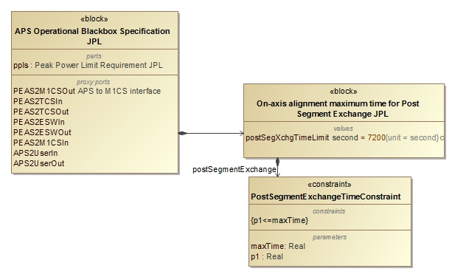
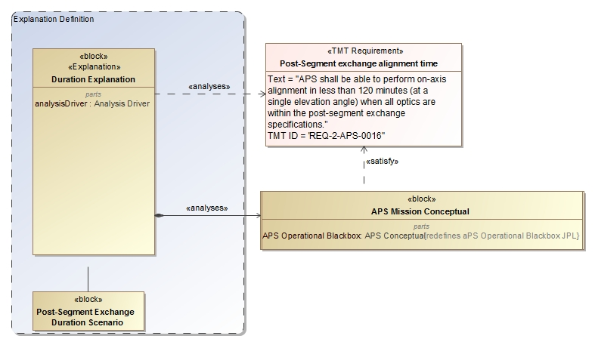
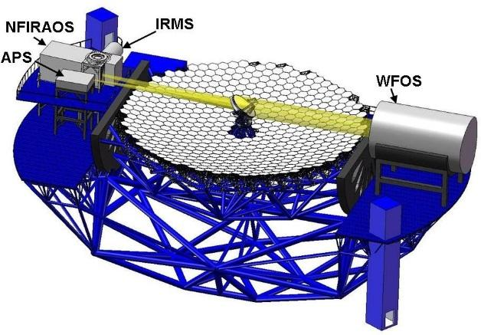
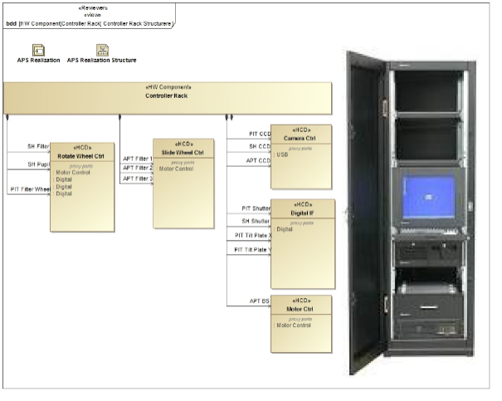
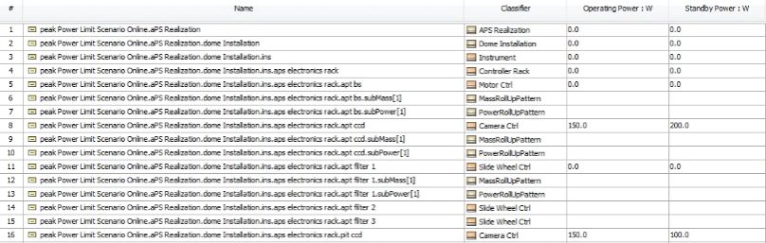
Analysis of Architecture and Design
Update Requirements
Analyze Conceptual Design
2
4
3
Analyze Realization Design/Specification
5
1
Max duration Post-segment exchange: 7200s 5000s
Number of exposures of 45s 4 6
Max peak power consumption in dome: 8.5kw 8.1kw Number of motors with 50W 10 12
6
Pass/fail
OCD, Requirements, ICD, DDD
Notes:
Touches on all modeling capabilities: construction, visualization, analysis, management, exchange and integration, collaboration and workflow

Slide 29
Model Walkthrough

Slide 30
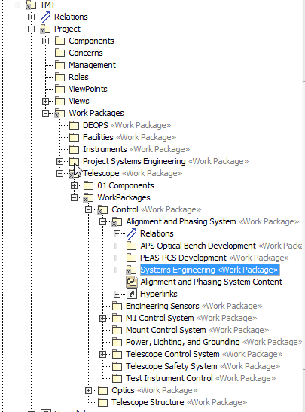
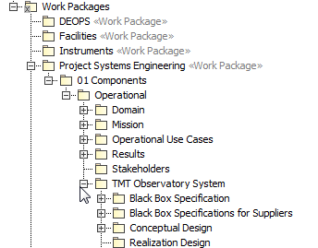
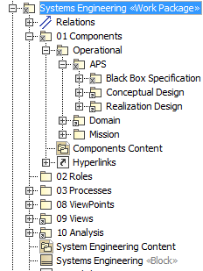
Model Organization & Package Structure
Organizing principles
Customer/Supplier relationship
Work Breakdown Structure
OOSEM abstraction layers

Slide 31
Executable System Engineering Method (ESEM)
Step 1: Formalize Requirements
Step 2: Specify Design
Step 3: Characterize Components
Step 4: Specify Analysis Context
Step 5: Specify Operational Scenarios
Step 6: Specify Analysis Configurations
Step 7: Run Analysis

Slide 32
Step 1: Formalize Requirements
Requirement Pattern
Customer Side
Define the textual requirement with a Requirement
Optionally define a design black box specification with a Block with relevant value properties
Optionally refine the Requirement with a Constraint Block on the black box design Block
Supplier Side
Define a design black box specification with a Block (that refines the customer’s black box Block if any and provides tighter property values)
Refine the textual Requirement by a Constraint Block (if not already defined by the customer)

Slide 33
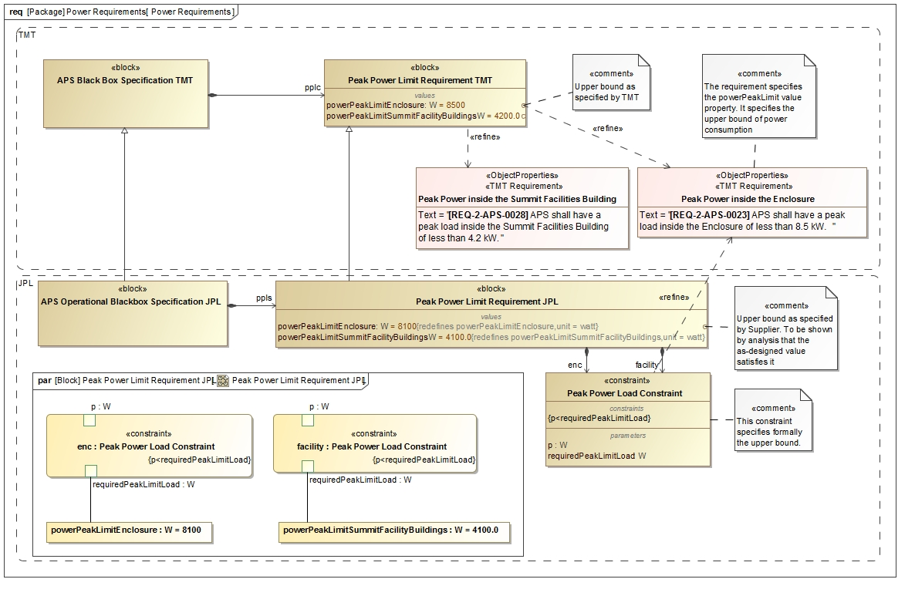
Step 1: Formalize Requirements

Slide 34


Slide 35
Step 2: Specify Design
Follow OOSEM to define two white box designs which specialize the black box design
Conceptual Specification
Realization Specification
Decompose the white box designs into Blocks representing the subsystems

Slide 36

Black Box Design Model
Operator
Project level components communicate with APS black box block
TCS
APS Black Box
M1CS
CS
ESW

Slide 37

Step 2: Conceptual Design Model
SH
PEAS
M1CS
Communication between state machine specified components over ports

Slide 38

Step 2: Realization Design Model
System Decomposition Hierarchy

Slide 39

Step 2: Realization Design Model
System Decomposition Hierarchy

Slide 40
Step 3: Characterize Components & Specify Behavior
Specify behavior of components
E.g., using SysML state machines for lifecycle behavior
E.g., using SysML activity diagrams for functional flow
Characterize Components, e.g., Using Patterns
Example: Roll-up Pattern
Constrained value represents an aggregate value that is propagating up a hierarchy of subcomponents
Static roll-up (e.g., mass roll-up)
Dynamic roll-up (e.g., power roll-up)

Slide 41



Step 3: Characterize Conceptual Components
1
Operational behavior captured with
state machines and activity models
2

Slide 42



Step 3: Characterize Conceptual Components
3
Dynamic and fixed duration constraints
1
Communicating
state machines
2
Duration analysis results verified against requirement for a particular configuration
4

Slide 43

Step 3: Characterize Realization Components
State constraints
Power Rollup Pattern

Slide 44

Step 3: Characterize Realization Components
Power Roll-up Pattern Application

Slide 45
Step 4: Specify Analysis Context
Analysis Context Pattern
Abstract analysis context Block composes both the design black box Block and white box Block
Analysis properties defined on the analysis context Block (e.g., peak power, power margin)
Analysis parametric model on the analysis context that computes and binds analysis values

Slide 46

Step 4: Specify Analysis Context
Analysis Context Pattern

Slide 47

Step 4: Specify Analysis Context
Analysis Context Parametric Model

Slide 48

Step 4: Specify Analysis Context

Slide 49

Step 4: Specify Analysis Context

Slide 50
Step 5: Specify Operational Scenarios
Operational Scenario Pattern
Concrete analysis context Block which
Represents one operational scenario (e.g., power configuration)
Specializes the abstract analysis context Block
Redefines context’s properties with scenario-specific values
Defines an owned behavior (sequence diagram) as scenario driver
Changes the states of the different components, by sending them signals, causing the rolling-up to occur automatically
Can specify duration constraints to time the injection of signals thus controlling time spent in a certain state
Can use state constraints (on components) to verify during execution if a component is actually in expected state

Slide 51

Step 5: Specify Operational Scenarios
Operational Scenario Pattern

Slide 52

Step 5: Specify Operational Scenarios
Operational Scenario Driver

Slide 53
Step 6: Specify Scenario Configurations
Scenario Condition Pattern
A decomposition tree of instance specifications representing the state of the scenario
Can be presented in tabular form
Rows represent the instance specifications (e.g., component)
Columns represent values (e.g., operating power) from the instance specifications
Issues
Hard to keep instance specifications in sync with Block hierarchy
Mitigation: tool automation

Slide 54


Step 6: Specify Analysis Configurations
Scenario Initial Condition Pattern

Slide 55
Step 7: Run Analysis
Run the configured analysis with a simulation engine on the initial conditions to get the final conditions:
Produce the following views on final conditions
Table showing final analysis values (e.g., peak power) and the constraint’s pass/fail status for each scenario
Timelines: state changes for components over time
Value profiles: total rolled up values over time

Slide 56

Timeline of component states

Slide 57

Duration Analysis results

Slide 58

Power Analysis

Slide 59

Power Analysis Results

Slide 60

System Level Analysis

Slide 61

Environments

Slide 62
OpenMBEE https://open-mbee.github.io/
OpenMBEE provides a platform for modeling that utilizes the Model Management System (MMS) that can be accessed from rich SysML desktop clients like MagicDraw, light-weight web-based client like View Editor, mathematical computation programs like Mathematica, and any other tool that can utilize RESTful web services.
The model repository provides the following features:
Basic Infrastructure for Version, Workflow, Access Control
Flexibility of content
Support for Web Applications and Web-based API access
Multi-tool and multi-repository integration across engineering and management disciplines

Slide 63


OpenMBEE Core Integration
Model of Document in
MagicDraw/Model Development Kit
MMS repository
Rendered and editable document in Web interface View Editor

Slide 64

Building the Viewpoint Model
Viewpoint Model
Purpose informed by Stakeholder Concerns
Methods and Analysis for constructing the View from the Model
Presentation Rules
Docgen https://github.com/Open-MBEE/mdk/tree/mdk-manual/src/main/dist/manual

Slide 65

Method and Analysis
Methods
Ordered steps for producing the View
Analysis
describe the nature of queries of the model
Analytical assertions
Rules for completeness and consistency
Format and Presentation Style
Describe the conventions, styles and formats for how the information is presented in the View

Slide 66

Integrated Document Generation And Simulation

Slide 67
Summary
Models are ubiquitous in domain engineering
Still many disconnected document based artifacts
Integration of requirements and behavioral/performance model
Method and infrastructure exist to tie in system level models into domain specific models
Leverage model executability (OOSEM + ESEM) and Co-simulation (FMI) and Co-Analysis
Automated requirements verification of architecture and design
Consistent Model Based Project Documentation

Slide 68
Acknowledgments
The research was carried out at the Jet Propulsion Laboratory, California Institute of Technology, under a contract with the National Aeronautics and Space Administration and NoMagic.
The TMT Project gratefully acknowledges the support of the TMT collaborating institutions. They are the Association of Canadian Universities for Research in Astronomy (ACURA), the California Institute of Technology, the University of California, the National Astronomical Observatory of Japan, the National Astronomical Observatories of China and their consortium partners, and the Department of Science and Technology of India and their supported institutes. This work was supported as well by the Gordon and Betty Moore Foundation, the Canada Foundation for Innovation, the Ontario Ministry of Research and Innovation, the National Research Council of Canada, the Natural Sciences and Engineering Research Council of Canada, the British Columbia Knowledge Development Fund, the Association of Universities for Research in Astronomy (AURA) and the U.S. National Science Foundation.

Slide 69
References
Karban, R., Jankevičius, N., Elaasar, M. “ESEM: Automated Systems Analysis using Executable SysML Modeling Patterns”, (to appear in the proceedings of INCOSE International Symposium (IS), Edinburgh, Scotland, 2016.)
Karban R., Dekens F., Herzig S., Elaasar M, Jankevičius N., “Creating systems engineering products with executable models in a model-based engineering environment”, SPIE, Edinburgh, Scotland, 2016
Karban, R., “Using Executable SysML Models to Generate Systems Engineering Products”, NoMagic World Symposium, Allen, TX, 2016
Open Source TMT model: https://github.com/Open-MBEE/TMT-SysML-Model
Open Source Engineering Environment: https://open-mbee.github.io/
Docgen, View&ViewPoints: https://github.com/Open-MBEE/mdk/tree/mdk-manual/src/main/dist/manual
JPL Model-Based Systems Engineering Case Study: http://omgwiki.org/MBSE/lib/exe/fetch.php?media=mbse:incose_mbse_iw_2017:iw_2017_open_mbee.pdf
A Practical Guide to SysML, 3rd Edition, Chapter 17 by Friedenthal, Moore, and Steiner
Zwemer, D., “Connecting SysML with PLM/ALM, CAD, Simulation, Requirements, and Project Management Tools”, May 2016

